Slide 1
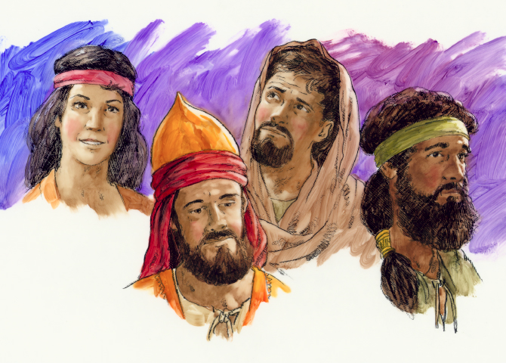
Great Leaders
Judges 3:7-30
Dr. Rick Griffith, Crossroads International Church Singapore
BibleStudyDownloads.org

Slide 2

Science Quiz

Slide 3
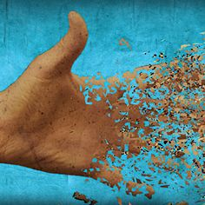
What is the Second Law of Thermodynamics?

Slide 4

The Second Law of Thermodynamics
"The world is winding down…"

Slide 5
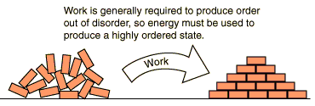
The Second Law of Thermodynamics
Work is generally required to produce order out of disorder, so energy must be used to produce a highly ordered state.
Work
Is our world better or worse than twenty years ago?
Notes:
Singapore has more MRT lines, high wages, better food, nicer clothes, more travel, and a host of other benefits. But we also have a far higher divorce rate and a host of other problems.
What applies corporately also applies personally.

Slide 6
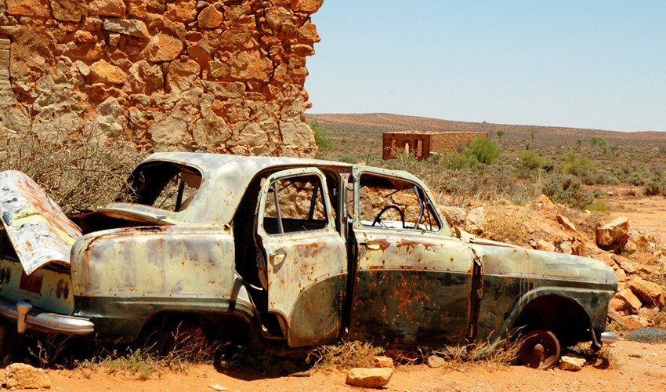
How can you prevent the Second Law of Thermodynamics from hurting your own life?

Slide 7

How can we combat the Second Law of Thermodynamics in our church?

Slide 8
Deuteronomy 7:1-4
"When the LORD your God brings you into the land you are entering to possess and drives out before you many nations – the Hittites, Girgashites, Amorites, Canaanites, Perizzites, Hivites, and Jebusites, seven nations larger and stronger than you – and when the LORD your God has delivered them over to you and you have defeated them, then
you must destroy them totally."

Slide 9
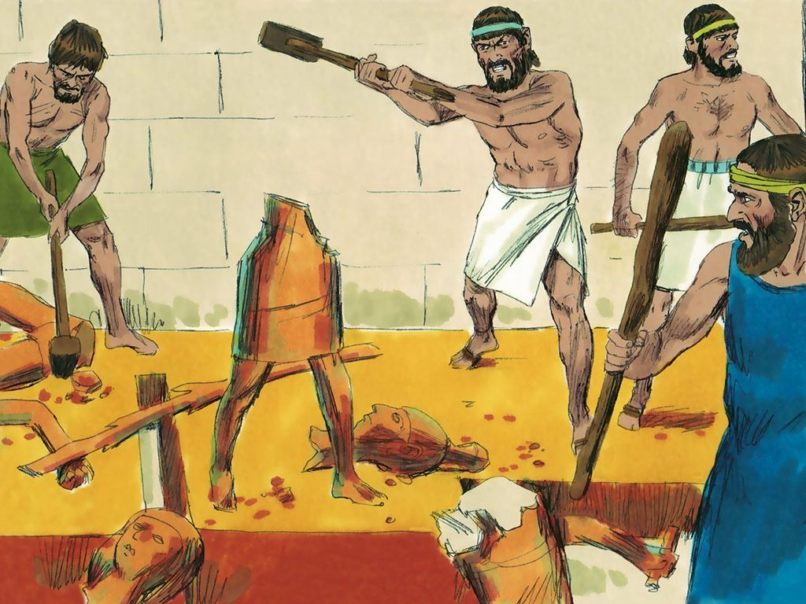
Destroying Pagan Images

Slide 10
Deuteronomy 7:1-4
"Make no treaty with them, and show them no mercy. Do not intermarry with them. Do not give your daughters to their sons or take their daughters for your sons, for they will turn your sons away from following me to serve other gods, and the LORD's anger will burn against you and
will quickly destroy you."

Slide 11
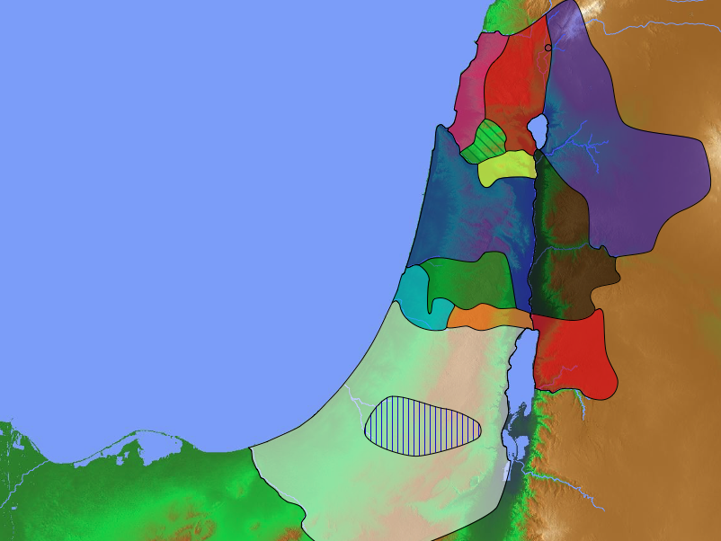
Grades for the Tribes of Israel
171
Asher
F
Naphtali
D
Judges 1:1-35
Zebulun
D
Manasseh
Issachar
D
Manasseh
Levites
Spread Throughout Israel
Gad
F
A
Ephraim
Dan
F
F
Benjamin
Reuben
Judah
F
F
A
Simeon
A

Slide 12
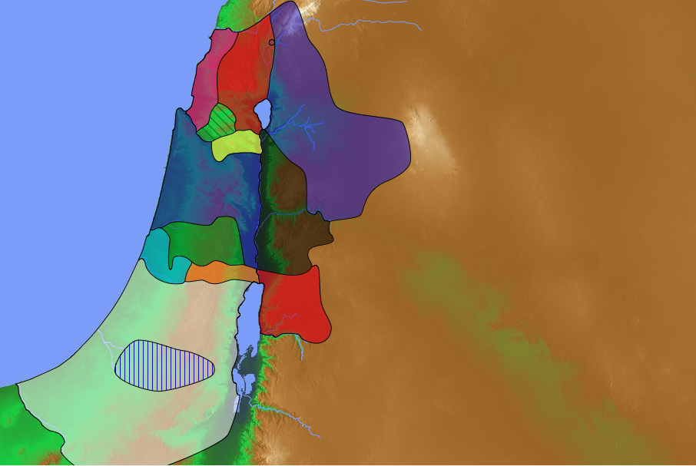
Enemies in Canaan During the Judges (3:5)
Mesopo
tamians
181
Sidonians
Phoenicians
Amorites
Canaanites
A m o r i t e s
Ammonites
Perizzites
Hivites
Jebusites
Philistines
Moabites
Amalekites
Edomites

Slide 13
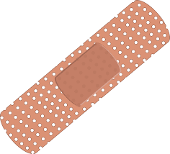
Band-Aids on a Gunshot Wound
Lessons from Judges

Slide 14
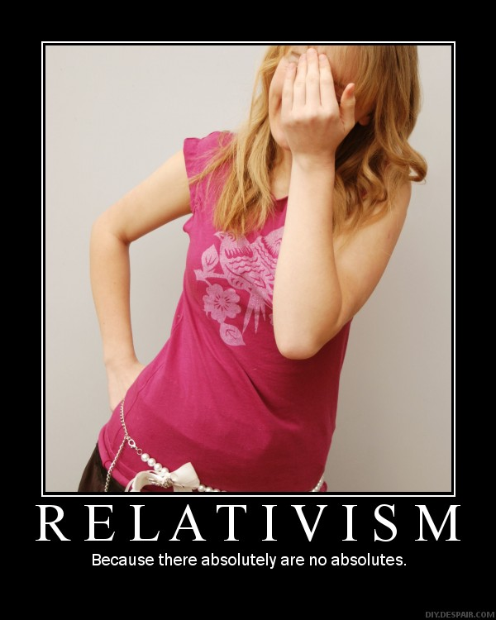
RELATIVISM
Because there absolutely are no absolutes.

Slide 15
Key Verse
172
"In those days Israel had no king;
everyone did as he saw fit
(what was right in his own eyes)"
(Judges 17:6; 21:25)
Judges

Slide 16
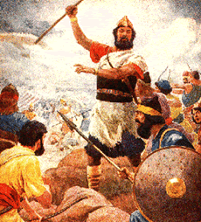
Warnings for Kings (1400 BC)
"You are about to enter the land the LORD your God is giving you. When you take it over and settle there, you may think, 'We should select a king to rule over us like the other nations around us.' ¹⁵ If this happens, be sure to select as king the man the LORD your God chooses. You must appoint a fellow Israelite; he may not be a foreigner"
(Deut. 17:14-15 NLT).

Slide 17
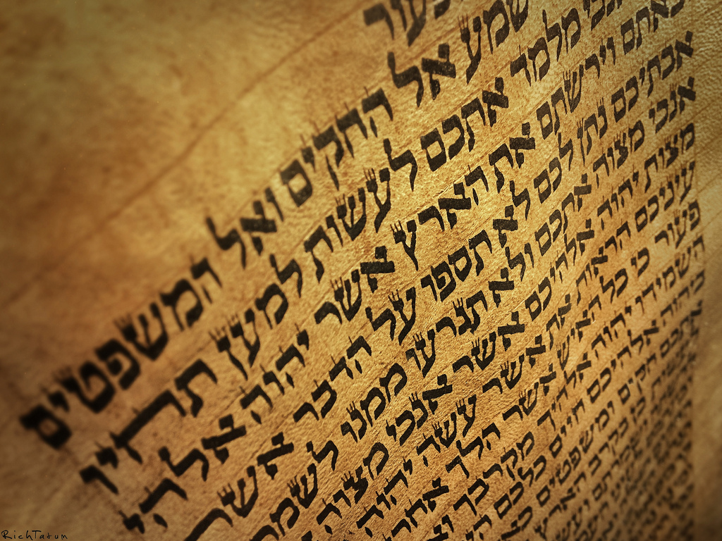
Warnings for Kings (1400 BC)
"When he sits on the throne as king, he must copy for himself this body of instruction on a scroll in the presence of the Levitical priests.
¹⁹He must always keep that copy with him and read it daily as long as he lives. That way he will learn to fear the LORD his God by obeying all the terms of these instructions and decrees"
(Deut. 17:18-19 NLT).

Slide 18
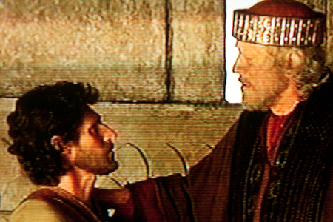
Warnings for Kings (1400 BC)
"This regular reading will prevent him from becoming proud and acting as if he is above his fellow citizens. It will also prevent him from turning away from these commands in the smallest way"
"And it will ensure that he and his descendants will reign for many generations in Israel"
(Deut. 17:20 NLT).

Slide 19
Judges of Israel
174
Peace 5x
Peace 4x
Peace 2x
Peace 6x
Oppression 3x
Oppression 2x

Slide 20

The Cycle Repeated in Judges
174
1 Sin
2 Servitude
5 Silence
3 Supplication
4 Salvation

Slide 21
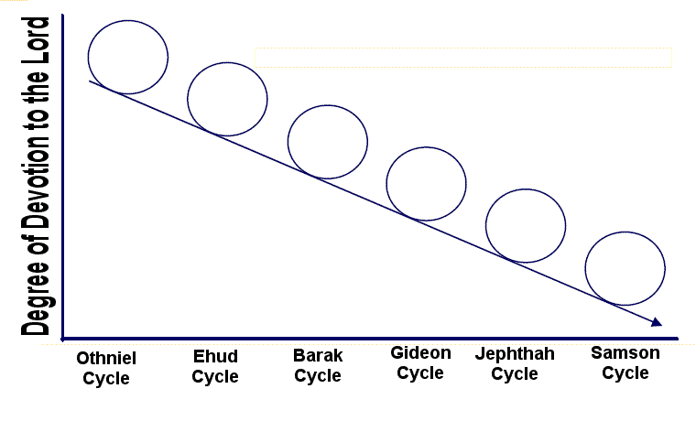
Downward Spiral of the Cycles
Degree of Devotion to the LORD
Othniel
Cycle
Ehud
Cycle
Barak
Cycle
Gideon
Cycle
Jephthah
Cycle
Samson
Cycle

Slide 22
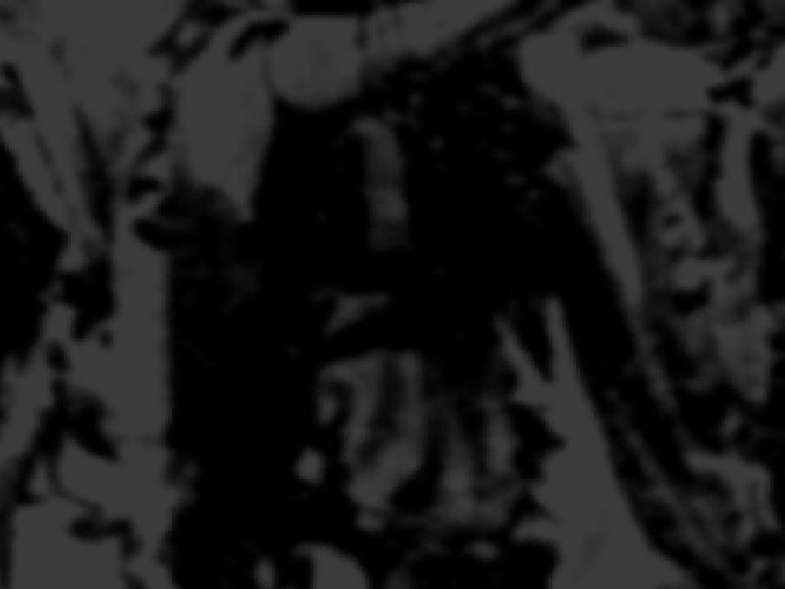
Southern Campaign (3:7-31)
172
Failure Under the Theocracy
Incomplete
Occupation
Need
for Monarchy
Deliverance by Judges
How did God prevent the Second Law of Thermodynamics from hurting Israel?
1:1–2:5
2:6–16:31
17–21
Deterioration
Discipline
Depravity
Causes
Of the Cycles
Curse
Of the Cycles
Conditions
Of the Cycles
Living with
the Canaanites
War with
the Canaanites
Living Like
the Canaanites
Military
Disobedience
1
Spiritual
Disobedience
2:1-5
Intro
2:6-3:6
South
3:7-31
Canaan
c. 341 Years (1390-1049 BC)

Slide 23
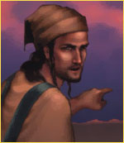
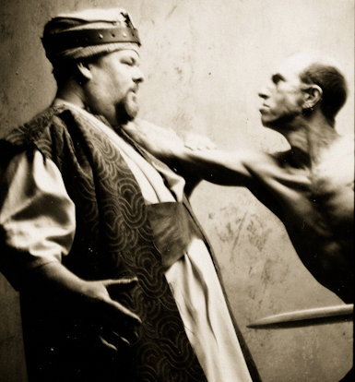
I. God delivered Israel from idolatry through two judges (3:7-30).

Slide 24
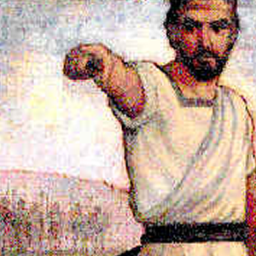
Othniel
Cycle 1

Slide 25
The Cycle Repeated in Judges
174
1 Sin
"The Israelites did evil in the LORD's sight. They forgot about the LORD their God, and they served the images of Baal and the Asherah poles" (3:7).

Slide 26
Terms Easily Confused
Asherah
Ashtoreth
"wooden pillars or images used as objects of idolatrous worship"
(Judges 3:7)
"consort of Baal"
(Judges 2:13)
Notes:
F. Duane Lindsey, "Judges," in The Bible Knowledge Commentary: An Exposition of the Scriptures, ed. J. F. Walvoord and R. B. Zuck, vol. 1 (Wheaton, IL: Victor Books, 1985), 385–386.

Slide 27
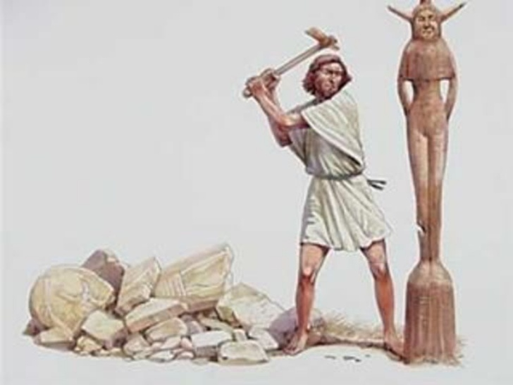
"That night the LORD said to Gideon, 'Take the second bull from your father's herd, the one that is seven years old. Pull down your father's altar to Baal, and cut down the Asherah pole standing beside it'"
Judges 6:25 NLT
Notes:
cf. Ex. 34:13; Deut. 16:21

Slide 28
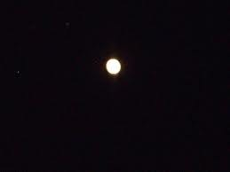
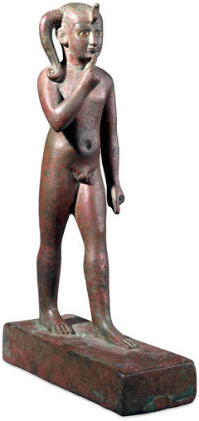
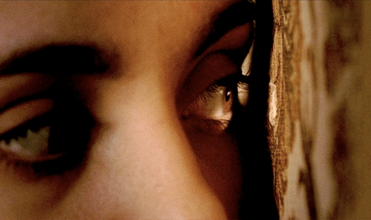
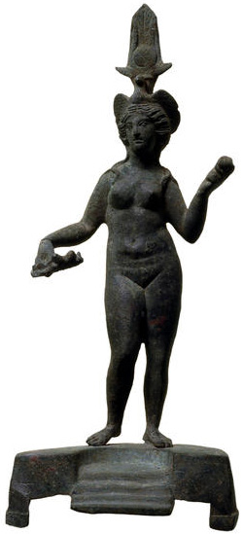
The Baal Cycle
Baal Rises
Baal Rises
Mot kills Baal
Mot kills Baal
Winter
Spring
Summer
Fall
Winter
Spring

Slide 29
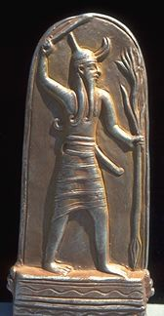
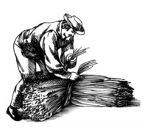

Religion
90
Baal fertility cycle (Baal Epic)
Mot (death) in winter defeated by Baal (life) in spring
Temple prostitution and sexual fertility rites in religious worship helped Baal resurrect in spring

Slide 30
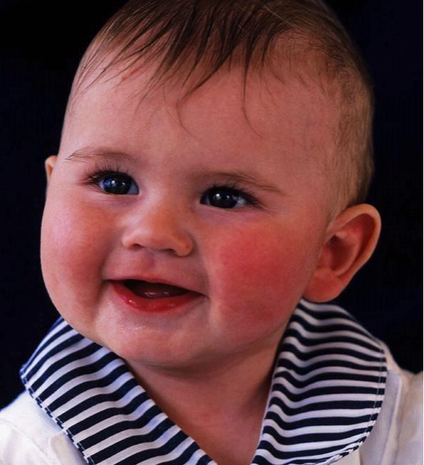
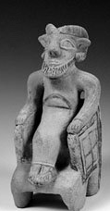
Child Sacrifice to Baal
91
During worship live babies were placed on the burning hot hands of the statue of Baal.
After dying they were then pushed into a hole underneath.
Notes:
Baalbek Temple and Human Sacrifice worship to Baal
Posted on July 18, 2012
Accessed 28 Aug 2016
http://www.ancientdestructions.com/baalbek-temple-human-sacrifice-worship-baal/

Slide 31
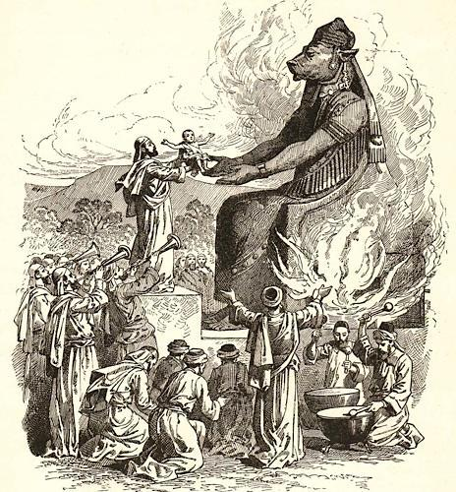
Child sacrifice to Molech

Slide 32
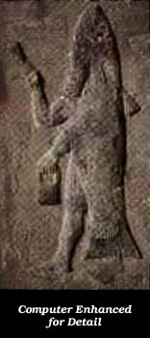
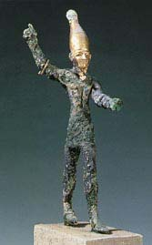
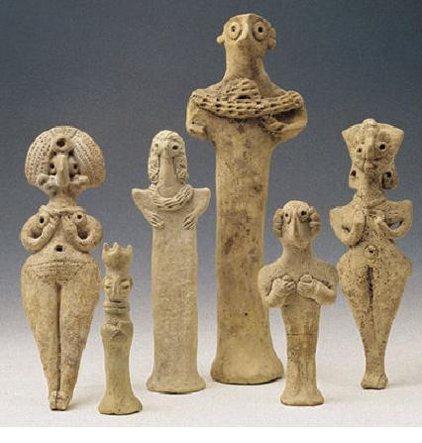
False Gods of the Land
A
S
T
H
A
R
O
T
H
DAGON
BAAL

Slide 33
Similar gods
Similar gods
160e

Slide 34
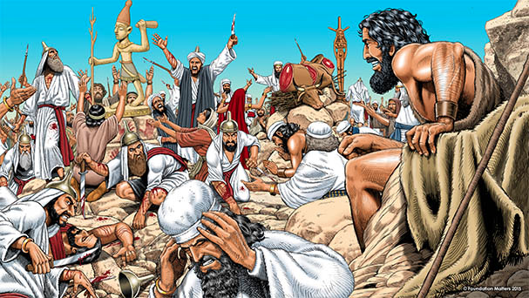
Elijah confronted the priests of Baal & Asherah —1 Kings 18

Slide 35
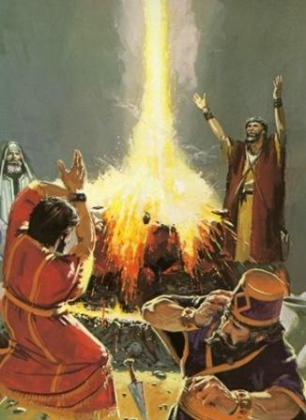
Elijah defeated the priests of Baal & Asherah
1 Kings 18

Slide 36
The Worst Religion of All
91
"The brutality, lust and abandon of Canaanite mythology is far worse than elsewhere in the Near East at the time. And the astonishing characteristic of Canaanite deities, that they had no moral character whatever, must have brought out the worst traits in their devotees and entailed many of the most demoralizing practices of the time, such as sacred prostitution, child sacrifice and snake worship."
Merrill F. Unger, Archaeology and the OT, 175

Slide 37
The Cycle Repeated in Judges
174
1 Sin
2 Servitude
"Then the LORD burned with anger against Israel, and he turned them over to King Cushan-rishathaim of Aram-naharaim. And the Israelites served Cushan-rishathaim for eight years" (3:8).

Slide 38
The enemy came from up north (3:8)
Naphtali
Cushan-Rishathaim
180a
Asher
Zebulun
Manasseh
Issachar
All
Israel
Manasseh
Gad
Ephraim
Dan
Benjamin
Reuben
Judah
Simeon

Slide 39
The Cycle Repeated in Judges
174
"But when the people of Israel cried out to the LORD for help…" (3:9a).
1 Sin
2 Servitude
3 Supplication

Slide 40
The Cycle Repeated in Judges
174
1 Sin
2 Servitude
"…the LORD raised up a rescuer to save them. His name was Othniel, the son of Caleb's younger brother, Kenaz" (3:9b).
3 Supplication
4 Salvation

Slide 41
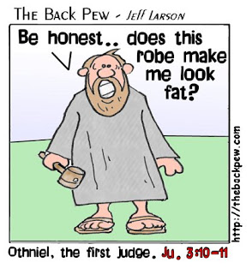
What kind of leader?

Slide 42

Things started well. Othniel was the best judge.

Slide 43
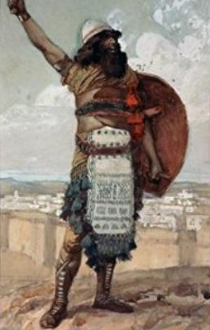
"God raised up Caleb's son-in-law Othniel to deliver the nation. His name means
'God is might,' and he lived up to his name"
Wiersbe's Expository Outlines on the Old Testament
Notes:
Warren W. Wiersbe, Wiersbes Expository Outlines on the Old Testament (Wheaton, IL: Victor Books, 1993), Jdg 35.

Slide 44
"The Spirit of the LORD came upon him, and he became Israel's judge. He went to war against King Cushan-rishathaim of Aram, and the LORD gave Othniel victory over him"
(3:10 NLT).

Slide 45
Where did Othniel judge (3:7-11)?
Naphtali
Cushan-Rishathaim
180a
Asher
Zebulun
Manasseh
Issachar
All
Israel
Manasseh
Gad
Ephraim
Dan
Benjamin
Reuben
Judah
Othniel
Simeon

Slide 46
The Cycle Repeated in Judges
174
"So there was peace in the land for forty years. Then Othniel son of Kenaz died" (3:11).
1 Sin
2 Servitude
5 Silence
3 Supplication
4 Salvation

Slide 47
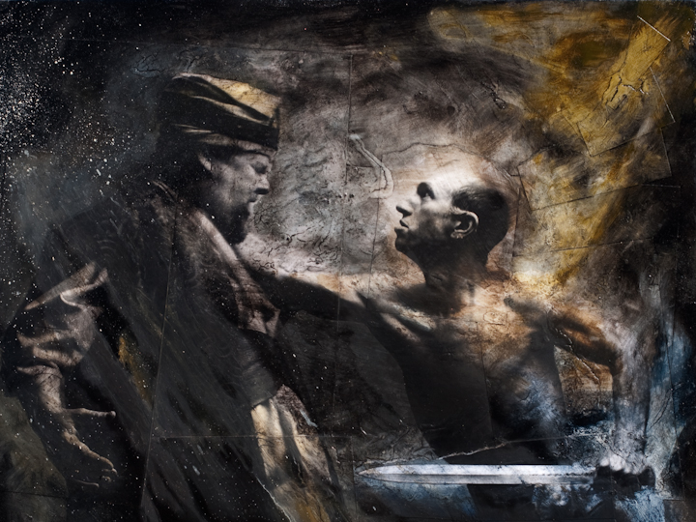
"Stick-it-to-'em" Ehud (Judges 3:12-30)
Cycle 2

Slide 48
The Cycle Repeated in Judges
174
"Once again the Israelites did evil in the LORD's sight…" (3:12a).
1 Sin

Slide 49
The Cycle Repeated in Judges
174
1 Sin
2 Servitude
"…and the LORD gave King Eglon of Moab control over Israel because of their evil" (3:12b).

Slide 50
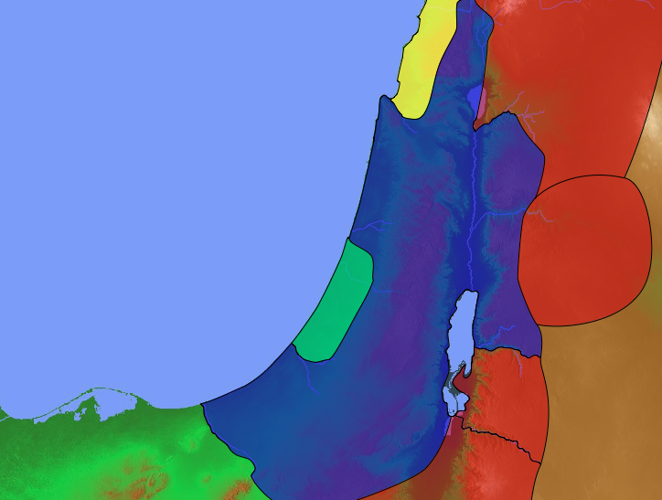

Ehud's Enemies
140
Phoenicia
Aram
"Eglon enlisted the Ammonites and Amalekites as allies, and then he went out and defeated Israel, taking possession of Jericho, the city of palms. ¹⁴And the Israelites served Eglon of Moab for eighteen years"
(3:13-14 NLT).
Israel
Jericho (City of Palms)
Ammon
Invaders of Israel
Philistia
Moab
Amalek

Slide 51
The Cycle Repeated in Judges
174
"But when the people of Israel cried out to the LORD for help…" (3:15a).
1 Sin
2 Servitude
3 Supplication

Slide 52
The Cycle Repeated in Judges
174
"…the LORD raised up a rescuer to save them. His name was Ehud son of Gera, a left-handed man of the tribe of Benjamin"
(3:15b).
1 Sin
2 Servitude
3 Supplication
4 Salvation

Slide 53
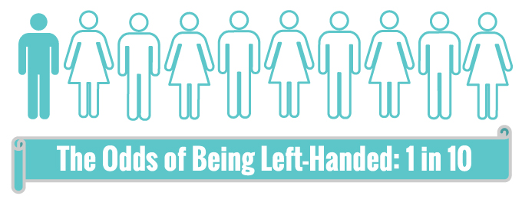
Left-Handed People

Slide 54
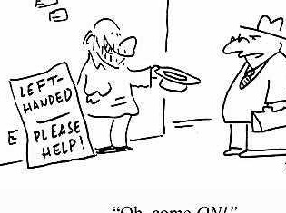
"Oh, come ON!"
LEFT-HANDED
___
PLEASE HELP!

Slide 55
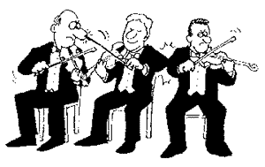
Left-handed Problems
Adapted from http://www.slideshare.net/srahimi69/new-microsoft-power-point-presentation-23985290

Slide 56
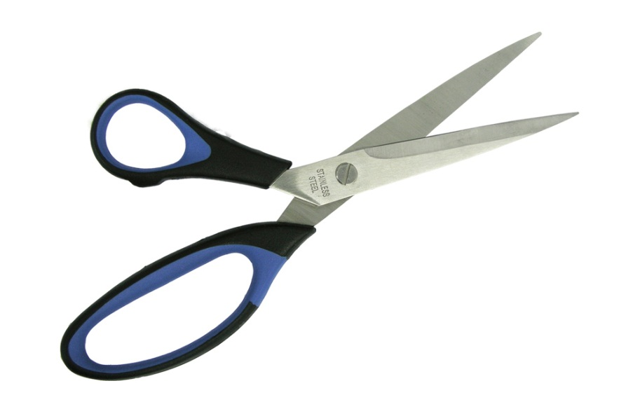
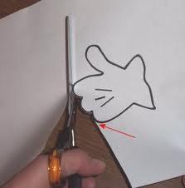
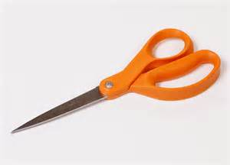
Left-handed Problems
We have to use special "lefty" scissors

Slide 57
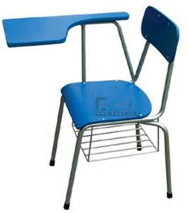
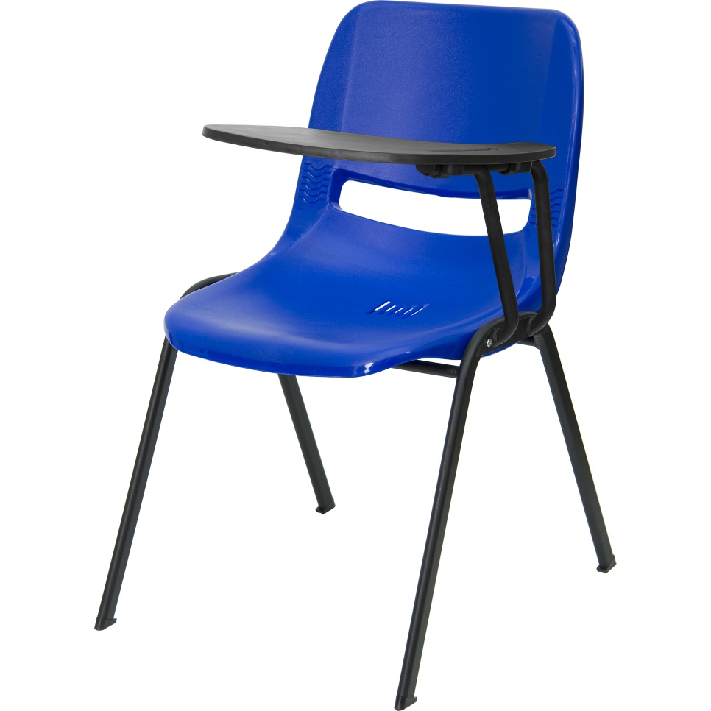
Left-handed Problems
Suitable Chair

Slide 58
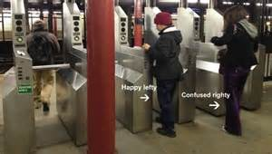
Left-handed Problems
Confusing to use metro tickets

Slide 59
How Lefty Are You?
You may be more lefty than you think
Are you left-eared?
Left eyed?
Here is a simple test you can apply to yourself.

Slide 60
1
Imagine the centre of your back is itching.
Which hand do you scratch it with?

Slide 61
2
Interlock your fingers.
Which thumb is uppermost?

Slide 62
3
Start clapping your hands.
Which hand is uppermost?

Slide 63
4
Wink at me.
Which eye does the winking?

Slide 64
5
Put your hands behind your back, one holding the other.
Which hand is doing the holding?

Slide 65
6
I'm whispering but you can't hear the words. Cup your ear to hear better.
Which ear do you cup?

Slide 66
7
Fold your arms.
Which forearm is uppermost?

Slide 67
Famous Left-handed Persons

Slide 68
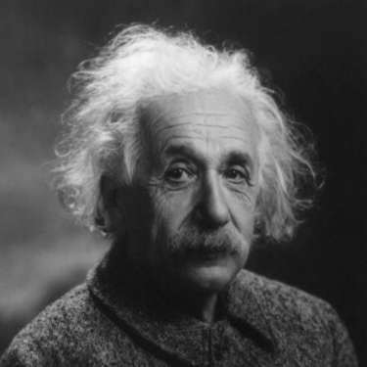
Albert Einstein

Slide 69
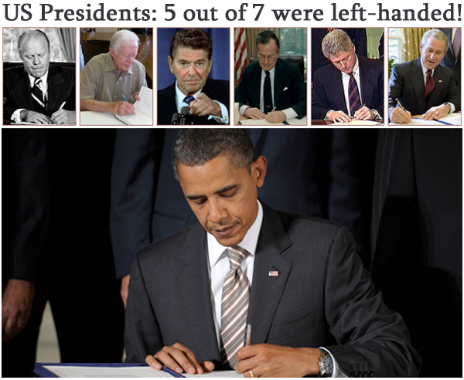

Slide 70
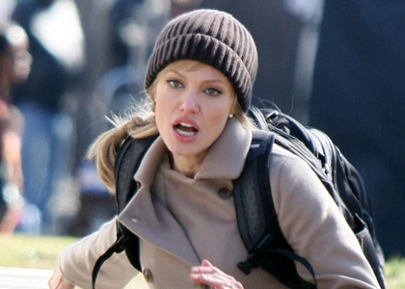
Angelina Jolie

Slide 71
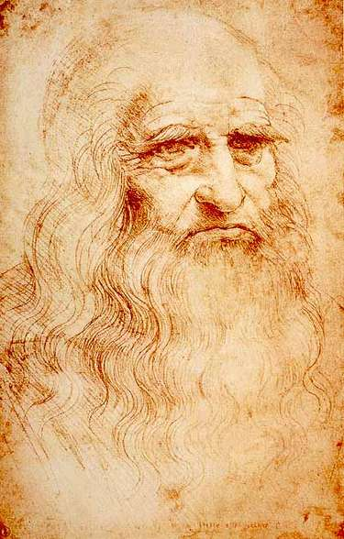
Leonardo da Vinci

Slide 72
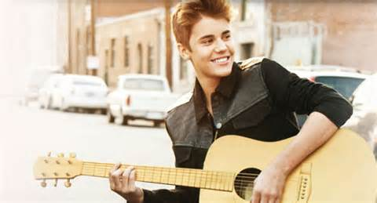
Justin Bieber

Slide 73

Mahatma Gandhi

Slide 74

Left-Handed People

Slide 75
Where did Ehud judge (3:12-30)?
Naphtali
180a
Asher
Zebulun
Manasseh
Issachar
Manasseh
Gad
"The Israelites sent Ehud to deliver their tribute money to King Eglon of Moab" (3:15b NLT).
Ephraim
Dan
Benjamin
Ehud
Reuben
Judah
Simeon
Moab

Slide 76

"So Ehud made a double-edged dagger that was about a foot long, and he strapped it to his right thigh, keeping it hidden under his clothing."
"He brought the tribute money to Eglon, who was very fat"
(3:16-17 NLT).

Slide 77

Southern Israel
140
Ehud of Benjamin
Gilgal
Judges 3
"After delivering the payment, Ehud started home with those who had helped carry the tribute. ¹⁹But when Ehud reached the stone idols near Gilgal, he turned back"
(3:18-19a NLT).
Moab

Slide 78
“[Ehud] came to Eglon and said…”
“So the king commanded his servants…”
Be quiet!
I have a secret message for you.
“and he sent them all out of the room” (3:19b)

Slide 79

"Ehud walked over to Eglon, who was sitting alone in a cool upstairs room. And Ehud said…”
I have a message from God for you.

Slide 80
"As King Eglon rose from his seat, ²¹Ehud reached with his left hand, pulled out the dagger strapped to his right thigh, and plunged it into the king's belly”
(3:20-21 NLT).

Slide 81

"The dagger went so deep that the handle disappeared beneath the king's fat. So Ehud did not pull out the dagger, and the king's bowels emptied.
²³Then Ehud closed and locked the doors of the room and escaped down the latrine" (3:22-23 NLT).

Slide 82
"After Ehud was gone, the king's servants returned and found the doors to the upstairs room locked. They thought he might be using the latrine in the room, ²⁵so they waited. But when the king didn't come out after a long delay, they became concerned and got a key. And when they opened the doors, they found their master dead on the floor"
(3:24-25 NLT).

Slide 83
Southern Israel
Hill Country of Ephraim
140
Seirah
Judges 3
Gilgal
"While the servants were waiting, Ehud escaped, passing the stone idols on his way to Seirah. ²⁷When he arrived in the hill country of Ephraim, Ehud sounded a call to arms. Then he led a band of Israelites down from the hills" (3:26-27 NLT).
Moab

Slide 84
Southern Israel
Hill Country of Ephraim
140
Judges 3
"'Follow me,' he said, 'for the LORD has given you victory over Moab your enemy.' So they followed him. And the Israelites took control of the shallow crossings of the Jordan River across from Moab, preventing anyone from crossing" (3:28 NLT).
Moab

Slide 85
Southern Israel
Hill Country of Ephraim
140
Judges 3
"They attacked the Moabites and killed about 10,000 of their strongest and most able-bodied warriors. Not one of them escaped" (3:29 NLT).
Moab

Slide 86
The Cycle Repeated in Judges
174
"So Moab was conquered by Israel that day, and there was peace in the land for eighty years" (3:30 NLT).
1 Sin
2 Servitude
5 Silence
3 Supplication
4 Salvation

Slide 87
How can you prevent the Second Law of Thermodynamics from hurting your own life?

Slide 88

II. God gives us leaders to help us conquer cycles of sin.

Slide 89

I need spiritual leaders.
I didn't get into leadership by myself.

Slide 90
Three Shepherd Tasks of Elders
236c1
Administration
(Serve, care for & testify)
Teaching
1 Tim. 3:2; 5:17
1 Tim. 3:1, 4-5; 5:17
Pastor-Teacher
Episkopos =
Epi "over" +
skopos "look" =
"watch over"
Eph. 4:11
Pastoring
(Protect & Lead)
1 Pet. 5:1-4
Acts 20:29, 35
1 Thess. 5:12

Slide 91

Elder Selection Process
Nominations
Aug 14-28
Interviews
Aug 29-Sep 17
Confirmations
Sep 18-Oct 2
Appointment
Oct 9
CIC By-Laws 3.2.8
Notes:
91
91
Our By-Laws give a four-step process to select elders.

Slide 92
Elder Qualifications
Qualifications - A nominee for elder shall have been a member of the church for at least six months in active service prior to the date of his nomination. The biblical qualifications for this position are set forth in 1 Timothy 3:1-7; Titus 1:6-9; and 1 Peter 5:2-3. That elders must be men is evident in the qualification to be a "husband of one wife" who "manages his house" (1 Tim. 3:2, 4; Tit. 1:6).
CIC By-Laws 3.2.2
Notes:
92
92

Slide 93


You need spiritual leaders too.

Slide 94

Study Character Traits
Notes:
Biblical Edlership Resources has this study to develop leaders.

Slide 95
Study Character Traits
Notes:
We will study these traits in the coming weeks in our Man2Man ministry.

Slide 96

Main Idea
Spiritual leaders will help you conquer cycles of sin.

Slide 97
I. God delivered Israel from idolatry through two judges (3:7-30).

Slide 98
II. God gives us leaders to help us conquer cycles of sin.

Slide 99

George Washington
Notes:
George Washington refused to be king as he shared leadership.
At the end of the Revolutionary War against the British, not surprisingly, the new nation voted for their General Washington to be the first US President.
Although the Constitution mandated a four-term term, no nation had ever done this before.
Therefore, many had doubts that Washington would give up power—so they were shocked to see him return to his home once his term ended!
He believed in shared leadership.

Slide 100
Black
Notes:
We need shared leadership here at our church. Be part of that process by praying for your elders and developing the leadership qualifications in yourself!

Slide 101


OT Preaching link at BibleStudyDownloads.org
Get this presentation and script for free!

